Slide 1

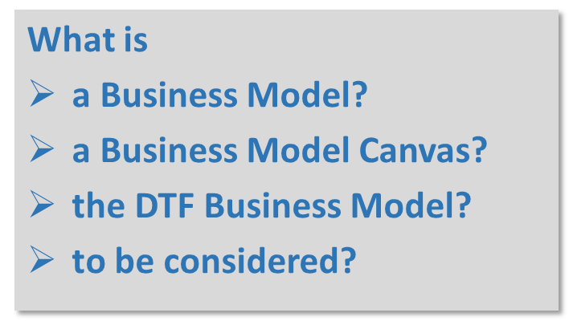

Slide 2
Business Model Introduction
According to you, what is a Business Model?
… and what is a Business Strategy?
Notes:
Let everyone write down 1 definition of Business Model and 1 definition of Business Strategy.
Collect the definitions on the pin board and compare, open the discussion.
Comment for facilitator: Business model is part of the business strategy:
business model is a description of how your business runs, Business strategy is the way how you will achieve the overall business goal (vision)

Slide 3
Business Model Introduction
business models are….
“…at heart, stories — stories that explain how enterprises work. A good business model answers […] age-old questions,
‘Who is the customer?
And what does the customer value?’
It also answers the fundamental questions every manager must ask:
How do we make money in this business?
What is the underlying economic logic that explains how we can deliver value to customers at an appropriate cost?”
Joan Magretta
“…really a set of assumptions or hypotheses”
Alex Osterwalder

Slide 4
Business Model Canvas
Organized way to lay out your assumptions about…
    value proposition,
    key resources,
    key activities ,
    customer relationships,
    channels,
    customer segments,
    cost structures, and
    revenue streams
…of your value chain

Slide 5
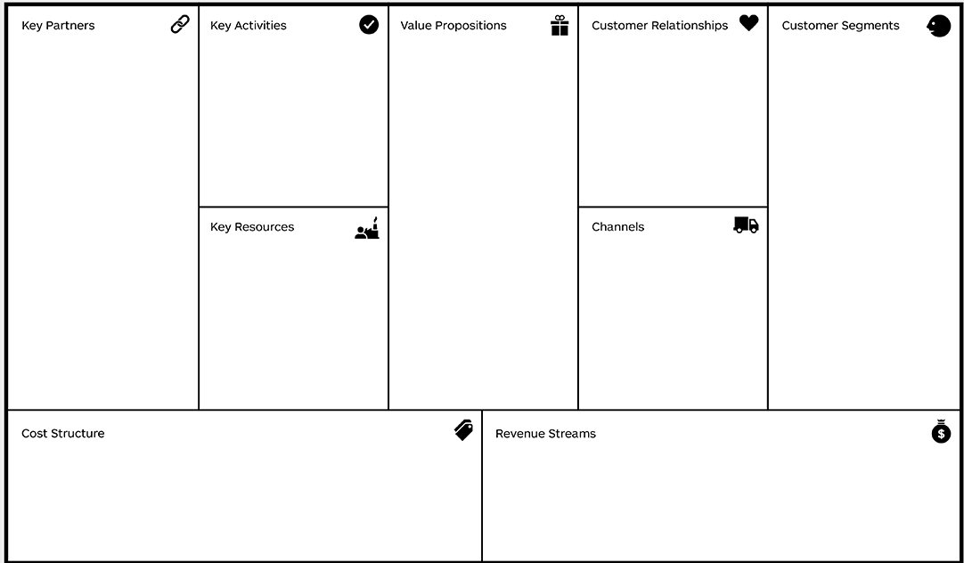
Business Model Canvas
Notes:
Each Aspect of the canvas will be explained and defined in the following.
Print in A3 for each WSP

Slide 6

Business Model Canvas
Value Proposition
  WHAT is the DTF offering?
  What value does the DTF create?
  Products?
  Services?
  Other Value?
What is the DTF value proposition?
Notes:
Give time to discuss and write down

Slide 7

Business Model Canvas
Key Activities
  Activities that are necessary to create the proposed value (services & products)
  What has to be done to make the DTF business work?

Slide 8

Business Model Canvas
Key Resources
  What resources does the DTF business rely on to create the proposed value (services & products)?

Slide 9

Business Model Canvas
Key Partners
  Which partnerships are crucial for the DTF Business´ success?
  Formal and informal

Slide 10

Business Model Canvas
Costs
  What costs are incured when creating the proposed value?
  What costs are related to Key Activities, Key Resources, Key Partnerships

Slide 11

Business Model Canvas
Customers
  Who are the DTF‘s customers?
  Customers that buy the DTF‘s services and products

Slide 12

Business Model Canvas
Customer Relationships
  How does the DTF interact with its customers?

Slide 13

Business Model Canvas
Channels
  How and where are the services / products delivered to the customers?

Slide 14

Business Model Canvas
Revenue
  What revenue streams does the DTF business have when creating the proposed value?
  What revenue comes in from different customers, relationship sand channels?

Slide 15
DTF Business Model Canvas example

Slide 16
What needs to be considered?
Implications for DTF Business Model
Notes:
A plenary discussion with all participants.
Examples
Scheduling is necessary (days/towns…)
Parallel septic tank could hold excess waste
Construct another DTF
Sludge drying bed can be used as buffer for thick sludge, where weather conditions allow (dry)
DTF may not meet the demand
Risk of illegal dumping
Sensitization is needed
For proper communication to avoid miscommunication
Make people (exhausters and community) understand the need for a schedule
Develop system for the entire process
Partnerships with other institutions/organizations (e.g. CBOs) to help monitoring toilets – to help with scheduling

Slide 17
What have we achieved today?
Understanding of the Business Model and Business Model Canvas
Development of a DTF Business Model
Discussion of aspects that need to be considered in the DTF Business Model
What else have we achieved or learnt? (voicing, your comments)

